Slide 1

Jonathan Marshall, MBA
  CIO/CCO/Partner
  As a Partner and Chief Investment Officer, Jon plays a pivotal role at Spectrum. He leads the design of our retirement plan educational materials and oversees all analytical research, including the development of our firm's model portfolios. As Chief Compliance Officer, he ensures adherence to all regulatory responsibilities. Guided by Warren Buffett's philosophy of long-term investing, Jon strives to build enduring solutions for our clients.
  Industry Start Date: 2003
  Spectrum Start Date: 2003
  Fun Fact: Jon and his wife are proud loving parents of twin daughters.
  Accreditations, Certifications & Education
    MS - Business Administration, DePaul University
    BS UW-La Crosse
    Investment Adviser Representative License (Series 65)

Slide 2
Please see important disclosures at the end of this review.
Notes:
Historical Analysis Returns Heatmap
• Key takeaway: leadership rotates every year. The best performer one year is rarely the best the next.
• Use this to anchor the case for diversification — a balanced approach captures winners without trying to predict them.
• Point clients to the "Asset Allocation" column to show how a diversified portfolio smooths the ride.

Slide 3
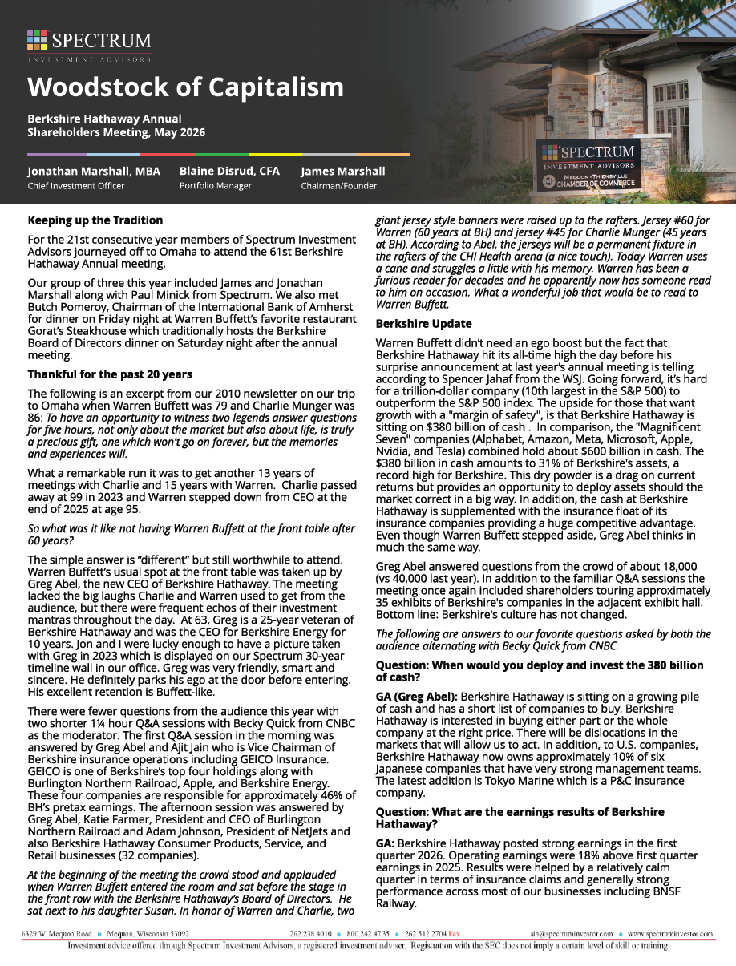
Woodstock of Capitalism
This year marked Spectrum Investment Advisors’ 21st visit to the Berkshire Hathaway Annual Shareholders Meeting in Omaha.
The event continues to offer invaluable insights from Warren Buffett and meaningful perspective on long-term investing, leadership, and market trends—a tradition the team looks forward to each year.

Slide 4
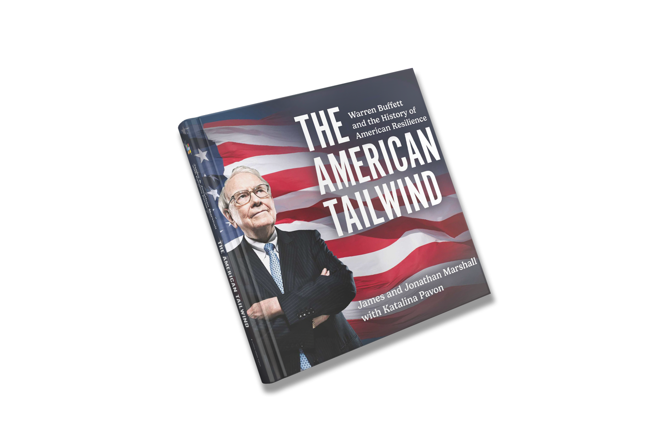

The American Tailwind
Book Sale
A captivating coffee table book that weaves together the extraordinary stories of Warren Buffett and the History of American Resilience.
Through vivid storytelling and stunning visuals, this book showcases how these elements intertwine to shape the foundation of American freedom.
TheAmericanTailwind.com

Slide 5
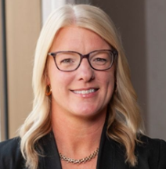
Emily Roland, CIMA
  Co-Chief Investment Strategist
Emily is responsible for developing and delivering timely market and economic insight to financial advisors and institutional investors across the United States. She co-authors “Manulife” John Hancock Investments' flagship quarterly market outlook publication, Market Intelligence, which combines insight from the firm’s global network of asset managers, independent research firms, broker-dealers, and banks with bottom-up fundamental and macroeconomic analysis.
Emily has been featured on CNBC and Bloomberg TV and is quoted frequently in the financial press, including the Wall Street Journal, Business Insider, and the Financial Times, and has served as a keynote speaker at a variety of industry conferences and events. She joined the firm's investments division in 2004 and has held several positions in product management, competitive intelligence, and market and industry research and, before joining the firm, she held roles at GMO and the Boston Stock Exchange. Emily earned an M.B.A. from Boston College and a B.B.A. from James Madison University and holds the Certified Investment Management Analyst designation.

