Slide 1

21st Annual Retirement Plan Seminar
  Date: June 17, 2026
WICPA is not affiliated with Spectrum Investment Advisors, Inc., and this is not an endorsement by WICPA of the products or services offered by Spectrum Investment Advisors, Inc.

Slide 2
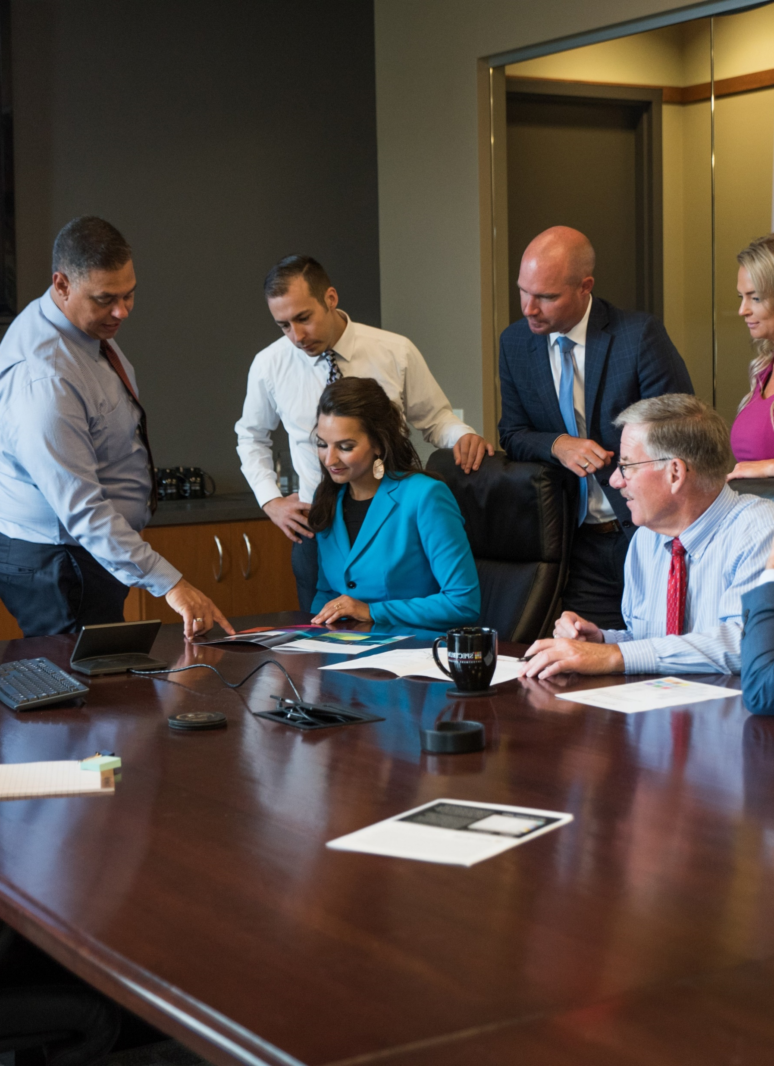
Seminar Agenda
  7:45 a.m. Hot Breakfast
  8:15 a.m. Welcome Remarks
  8:30 a.m. Retirement Plan Trends
  9:15 a.m. Break
  9:30 a.m. Economic & Financial Markets Review
  10:45 a.m. Break
  11:00 a.m. Real Lessons in Crisis Leadership & Decision Making
  12:15 p.m. Closing Remarks

Slide 3
  Welcome Remarks

Slide 4

Survey
Thank you for joining us!
We appreciate your time and participation.
Please take a moment to fill out our short survey — your feedback helps us grow and improve!

Slide 5


CE Credits
SHRM
HRCI

Slide 6
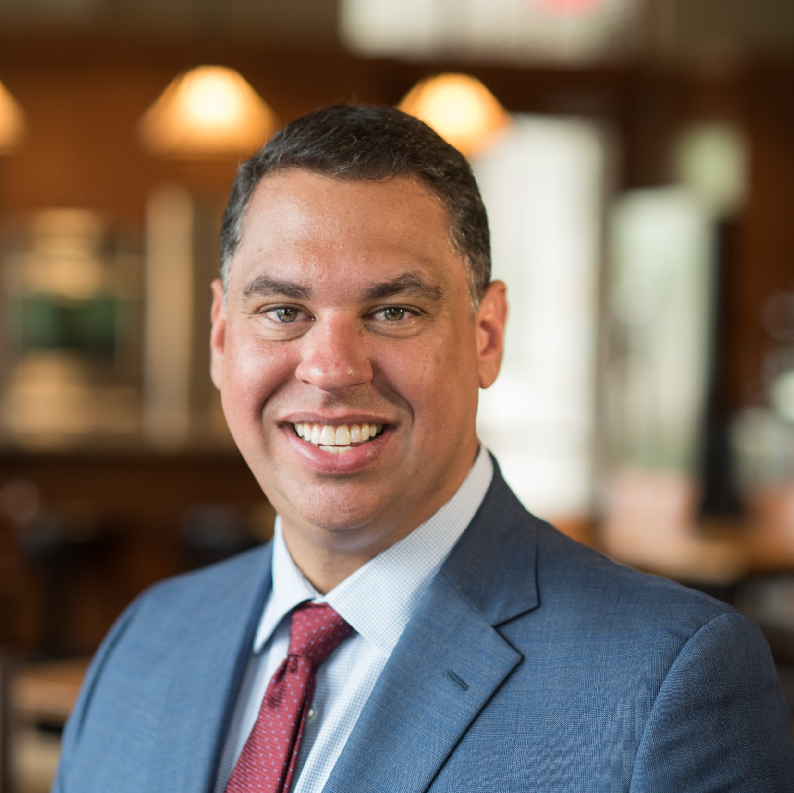
Manuel Rosado, MBA
  President/Partner
  Manuel, an industry expert, serves as President and Partner at Spectrum. He is instrumental in setting the firm's strategic direction and overseeing its day-to-day operations. With a deep understanding of fiduciary standards and behavioral finance, Manuel has a proven track record of helping companies implement successful retirement programs. His expertise in applying these concepts to investment management enables him to deliver actionable solutions that drive positive outcomes for the firm.
  Industry Start Date: 1989
  Spectrum Start Date: 2005
  Fun Fact: Manuel coached multiple youth sports including high school volleyball and enjoys travel, golf, pickleball, and the outdoors.
  Accreditations, Certifications & Education
    MBA - Finance, Concordia University-Wisconsin
    BA - Business Administration, Taylor University
    Certified Behavioral Finance Analyst (CBFA) certification from the AGI Center for Behavioral Finance
    Investment Adviser Representative License (Series 65)
  Organization Involvement
    Taylor University Board of Trustees – Board Vice Chair
    Eastbrook Academy - Board Member
    Port Washington State Bank - Bank Director

Slide 7
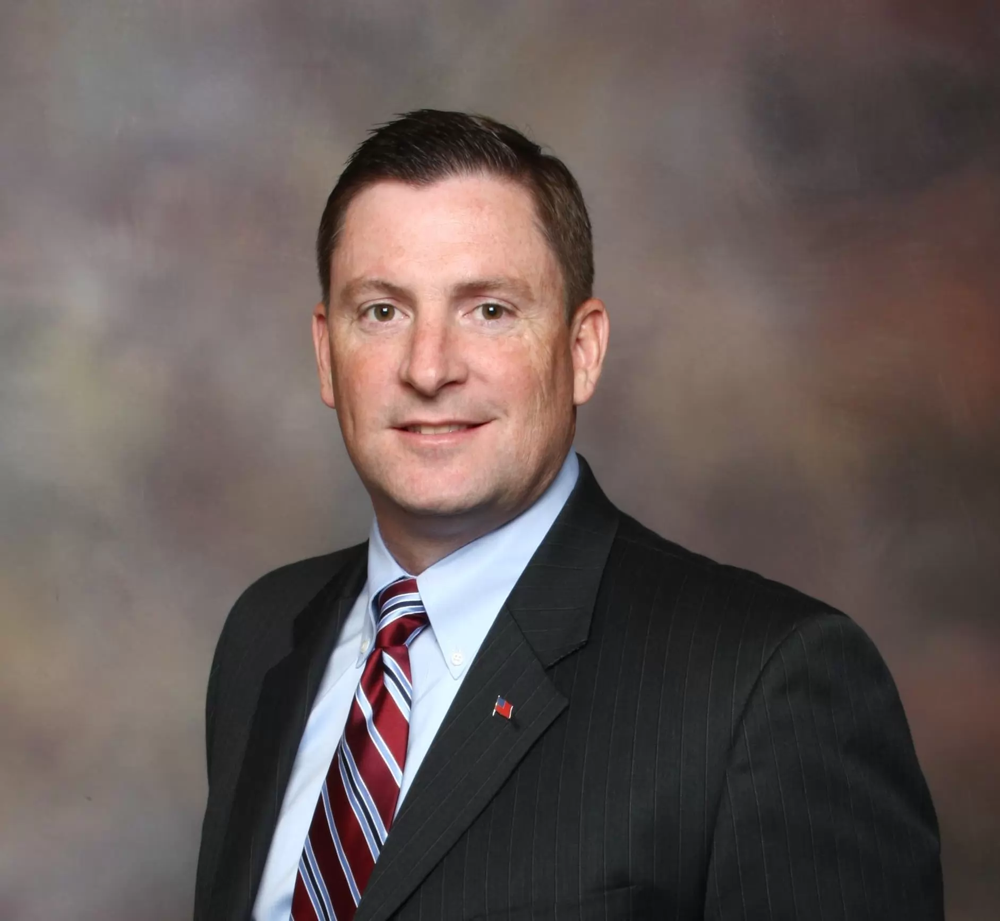
Lieutenant Colonel Robert J. Darling
  Retired Marine Corps.
Lt. Col. “Bob” Darling flew attack helicopters in Desert Shield and Desert Storm during the first Gulf War and in Somalia, Africa, in support of Operation Restore Hope. In June 1998, he was selected to fly as a presidential pilot with Marine Helicopter Squadron One and in October 2000, he was handpicked to work for the White House Military Office, Airlift Operations Department.
It was in that capacity that he supported the Vice President, National Security Advisor, and the National Command Authority, from inside the President’s Emergency Operations Center, within the White House on September 11, 2001.
Today Bob is the author of “24 Hours Inside the President’s Bunker, 9/11/01: The White House” and the President and CEO of Flash Emergency Management, a crisis leadership development and preparedness company located in Stafford, Virginia.

Slide 8
  Thank You

